Slide 1
Autonomous Drone Delivery System for Industry 4.0
Progress Report
Student Name: Jianhui Li
Supervised by: Dr. Tengyuan Zhang & Prof. Jun Yang
Submission Date: June 15st, 2018

Slide 2
Progress
Use c++ programming code linux system, build in raspberry PI
Successfully control M100 by using Raspberry PI.
Solve raspberry communication problem with PC by SSH
Learn Linux development in Visual Studio

Slide 3
Objectives
Control the drone to fly to a specific position by using raspberry PI
Solve problems due to system update

Slide 4
Reading/Literature Review
If you did any reading/literature review in the past two weeks, then:
DJI onboard SDK tutorial
Linux development by Visual Studio
DJI onboard API: https://developer.dji.com/onboard-api-reference/index.html

Slide 5
Current Challenges/Discussion
Using SSH to link Raspberry PI with PC takes many problems. It succeeded in last week, however, the windows 10 update bring some bugs, which takes me about one week to solve the problem. But then, it had new problem, the raspberry PI cannot communicate with M100 and PC at the same time. Therefore, these two weeks does not have many results.

Slide 6
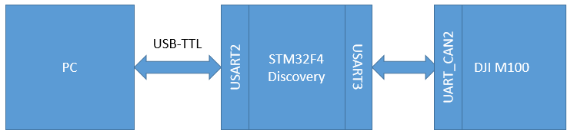
Lab 1: Control drone through Raspberry Pi
Introduction:
The drone m100 supplies API to for raspberry (Linux). We use onboard SDK function to control the drone. In this project, Raspberry Pi is used as the controller board.
Raspberry Pi

Slide 7
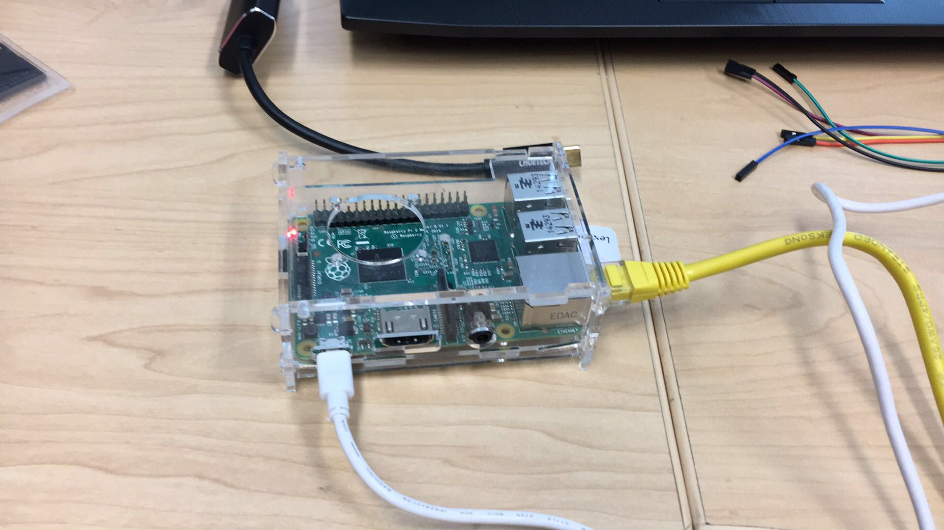
Progress 1:
Connect Raspberry Pi to laptop
Upload linux system into RPI
Install c++ IDE to write code
Build the code in raspberry Pi
Connect the RX, TX, GND pin to the UART port on m100
Start the drone and the remote controllor

Slide 8
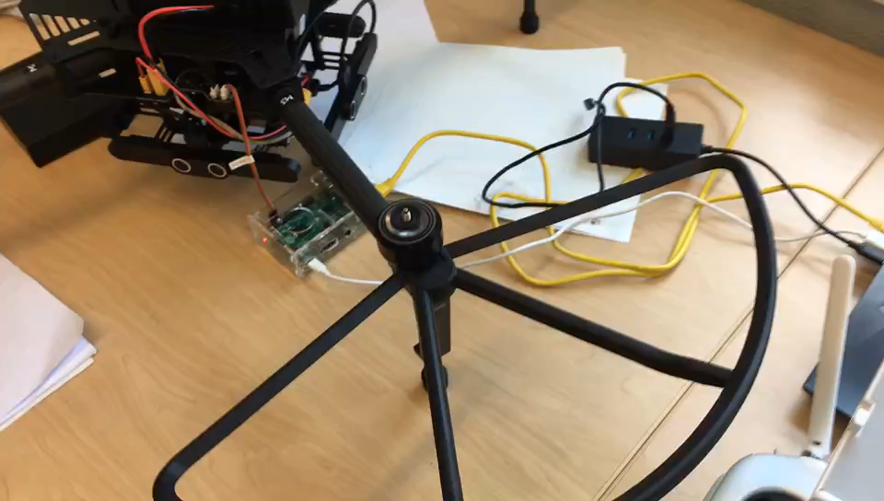
Observe the result:
We can see, the motor is rotating in a high speed. Next week, the drone will be tested in an empty groud.

Slide 9
Summary
In the last two weeks, it takes us too much time to solve the communicating bugs and learning how to compile in the Linux system. But, in the next week, the progress will speed up.

Slide 10
Future Plan
In the next two weeks, try to build communications between raspberry Pi and the guidance. The biggest problem is how to use raspberry Pi to communication with the third device. Because there only be a pair of RX TX pin. If I can get the data from guidance, it will be easier to reduce the error

